Slide 1
F&A Meeting
September 10th, 2024

Slide 2
UMB Active Threat Training Video
This video depicts fictional events on campus. Some content may be disturbing. It is intended as a learning and training tool.

Slide 3
Res Hall Prepared – FSE 2024
A Full-Scale Exercise is type of emergency management exercise that simulates a real-world event to test a variety of preparedness capabilities
UHS Post Trauma Debriefing (No Evaluation)

Slide 4
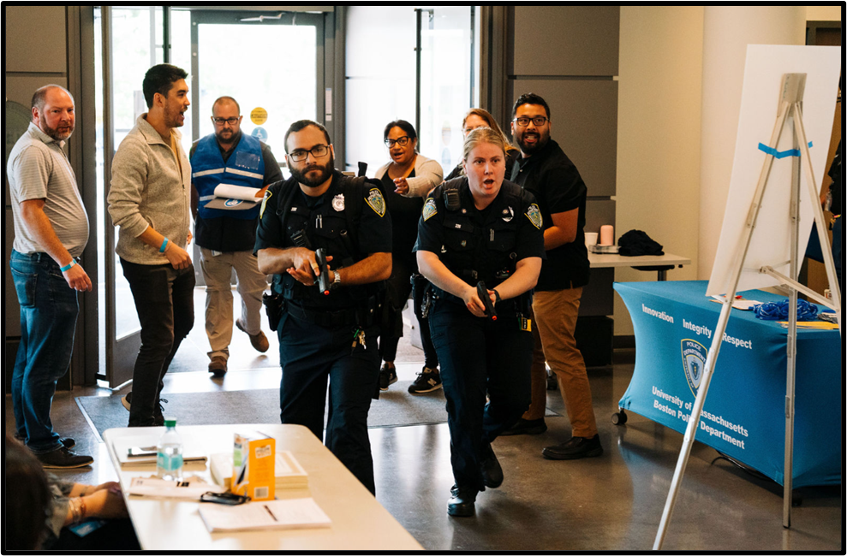
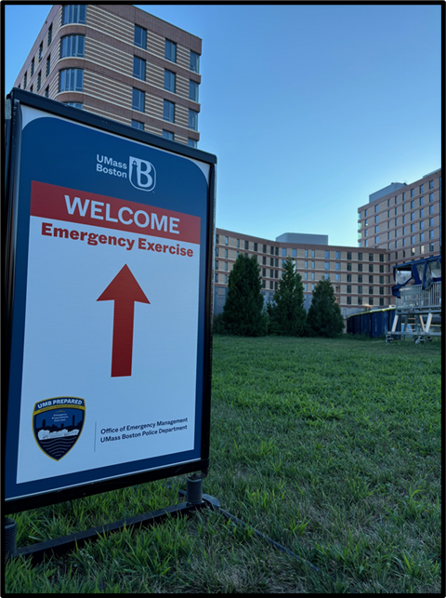
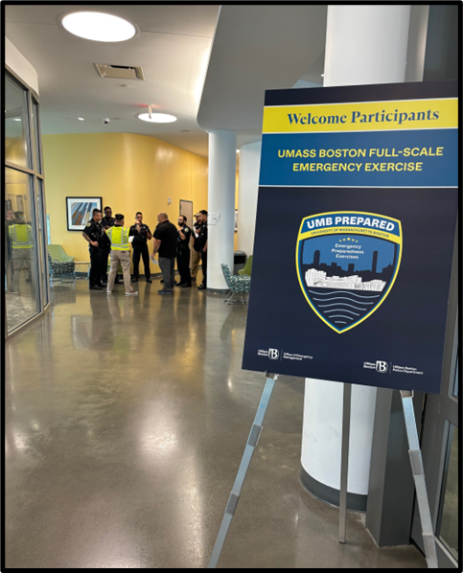
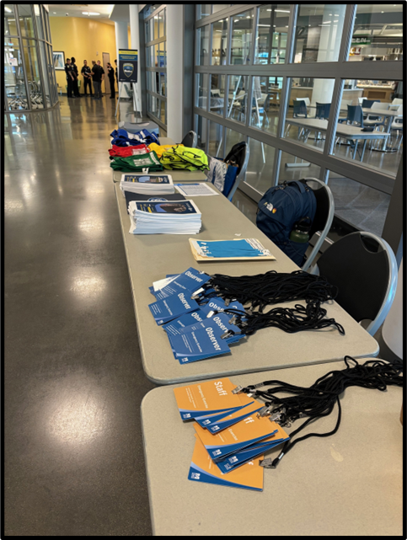
FSE 2024 Photos

Slide 5
Tabletop Exercises (TTX)
Tabletop exercises are discussion-based sessions where team members meet in an informal, classroom setting to discuss their roles during an emergency and their responses to a particular emergency.

Slide 6
After Action Reports
Emergency Management holds debrief on the incident/exercise/planned event and creates an After-Action Report
Document Incident Response
Document Strengths of Response
Capture Lessons Learned
Identify Areas for Improvement
Make recommendations to improve and assign owners

Slide 7
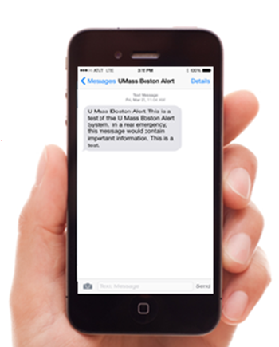
Campus Emergency Alert System
Mobile: Text, Email, Voicemail
Computer / TV pop up alerts
Outdoor HPSA Speakers
Social Media / Website
Alert Beacons

Slide 8
Other - Preparedness
www.umb.edu/preparedness - “What to do in an emergency”
Active Threat Training Video
Staying Safe on Campus Trainings (Sept 26th, Oct 17th @noon)
Panic Buttons in higher risk areas
Classroom Thumb turnkey Locks
Classroom Interior Identification / Emergency Guidelines
Exterior Door Identification

Slide 9
Questions?
Justin Comeau
Director of Emergency Management
Justin.Comeau@umb.edu

