Slide 1
UM-Plan:
Strategic Financial Planning & Analysis Tool
  Non-Personnel Budget Planning (Budget Planning File)
  Last update: September 2023

Slide 2
Guiding Principles
PeopleSoft is the source of record for data in UM-Plan.
UM-Plan data has been validated and updated as of September 11, 2023.
All line items should be reviewed and verified.
Personnel items will be managed through the Labor Plan file but will populate into Budget Plan files as read only data.

Slide 3
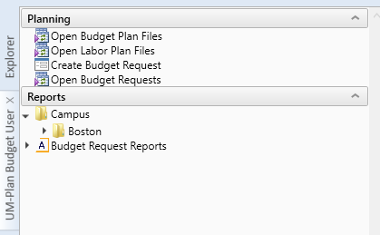
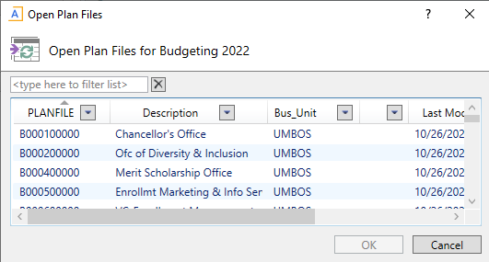
Navigation
Using the “UM-Plan Budget User” selection in Navigation Bar on the left, double click on Open Budget Plan File
Select a department plan file, and click “Ok”

Slide 4

Navigation Cont’d
The Plan file consists of three (3) Tabs:
    General Tab – General operating funds (GOF, GOF NTT, State, Tuition, State Fringe)
    All Other – Revenue based funds (RTF, ESS, Lab Fees, Etc.)
    Narrative – Summary that supports the department budget request

Slide 5





Fields
General & All Other Tabs
  Major Category & Account Description
  Previous Actuals and Current year YTD in any category & account with activity
  Current Year: UM-Plan (UMP) Base budget, UMP Total budget, PeopleSoft (PS) Base budget, PS One time budget, PS Total budget, Actual YTD thru September, FY24 Projected (editable)
  FY25 Base Starting Point, starting point for the proposed base in FY25 planning this is equal to FY23 actuals. FY25 Proposed Base is where areas will be able to input the TOTAL proposed budget in input total rows, cells are shaded blue and by default will start populated with the starting point, however for general funds in FY25 the budget office has preloaded target amounts.
  Budget Office Adjustment (changes made by budget office), Adjusted Proposed Base, Budget Year Total, Comments
2

Slide 6

Fields: Requiring Input
    FY 2024 Projected (not shown below)
      Note: this field initially will be auto-calculated, not a required field, but if it assists you in planning FY24 it can be helpful
    FY25 Proposed Base
      Field will be pre-populated with FY23 actual expenditures or in the case of general funds the initial target amounts, please enter the TOTAL value proposed when changing this value
    Comments – Additional information related to proposed base
    Note Budget Office Adjustment Column is editable, but is only to be used by the budget/provost office

Slide 7
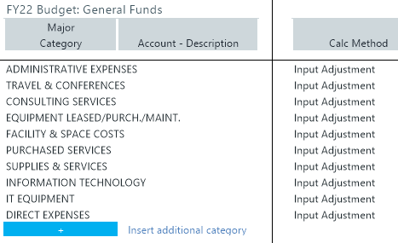

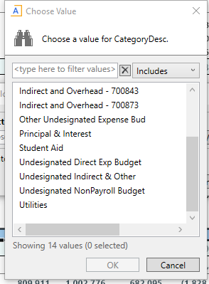
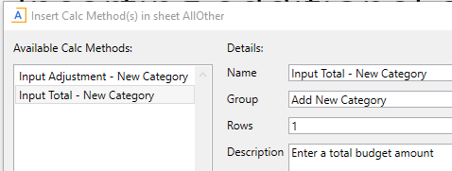
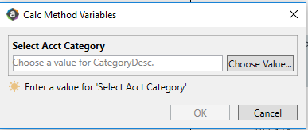
Inserting additional expense category
Inserting additional account & category
  Double click on the blue bar next to Insert additional account or insert additional category
  Select the input total option in first prompt
  Select the Account or Category after hitting “choose value” in second prompt

